Slide 1
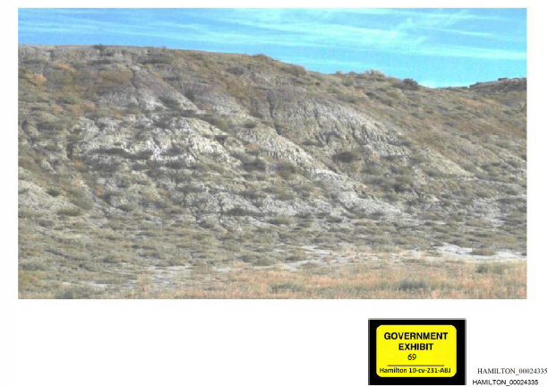
The “headwaters” of “Slick Creek” (as per the government’s expert)
Badlands east of worland

Slide 2
“Slick Creek” above irrigation
Similar to Hamilton property prior to formation of Hanover Irrigation District and conversion to farm ground

Slide 3
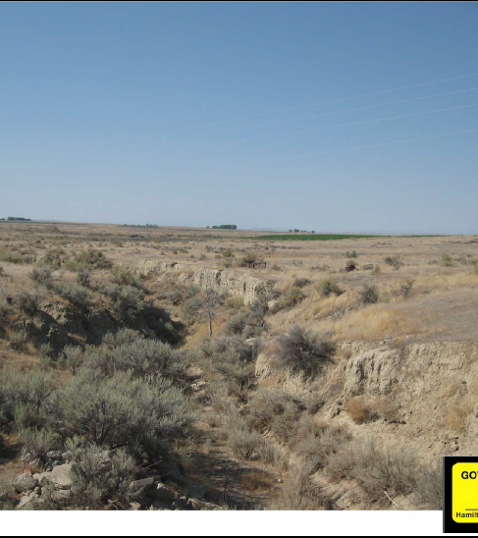
“Slick Creek” above irrigation
An “erosional feature” exempt from cwa

Slide 4
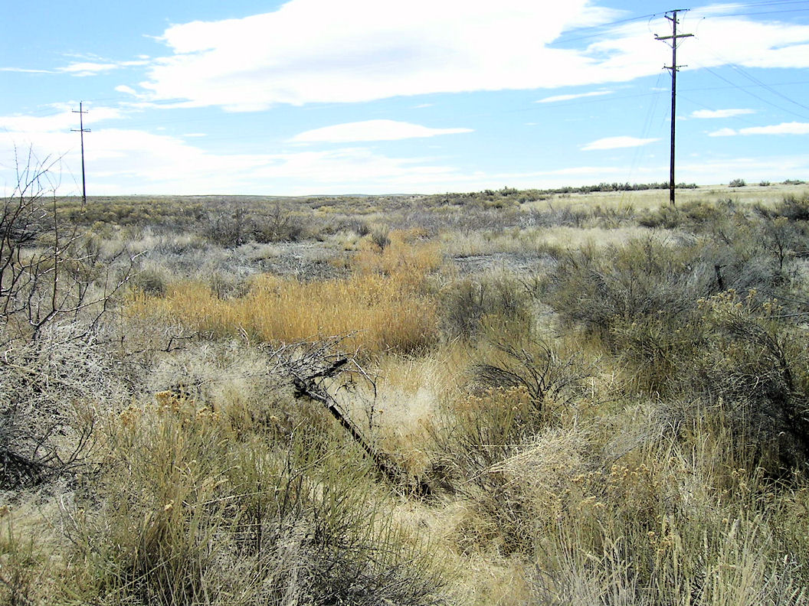
“Little Slick Creek,” a “tributary” to Slick Creek
At least according to epa

Slide 5
“Little Slick Creek”
At least according to EPA

