Slide 1
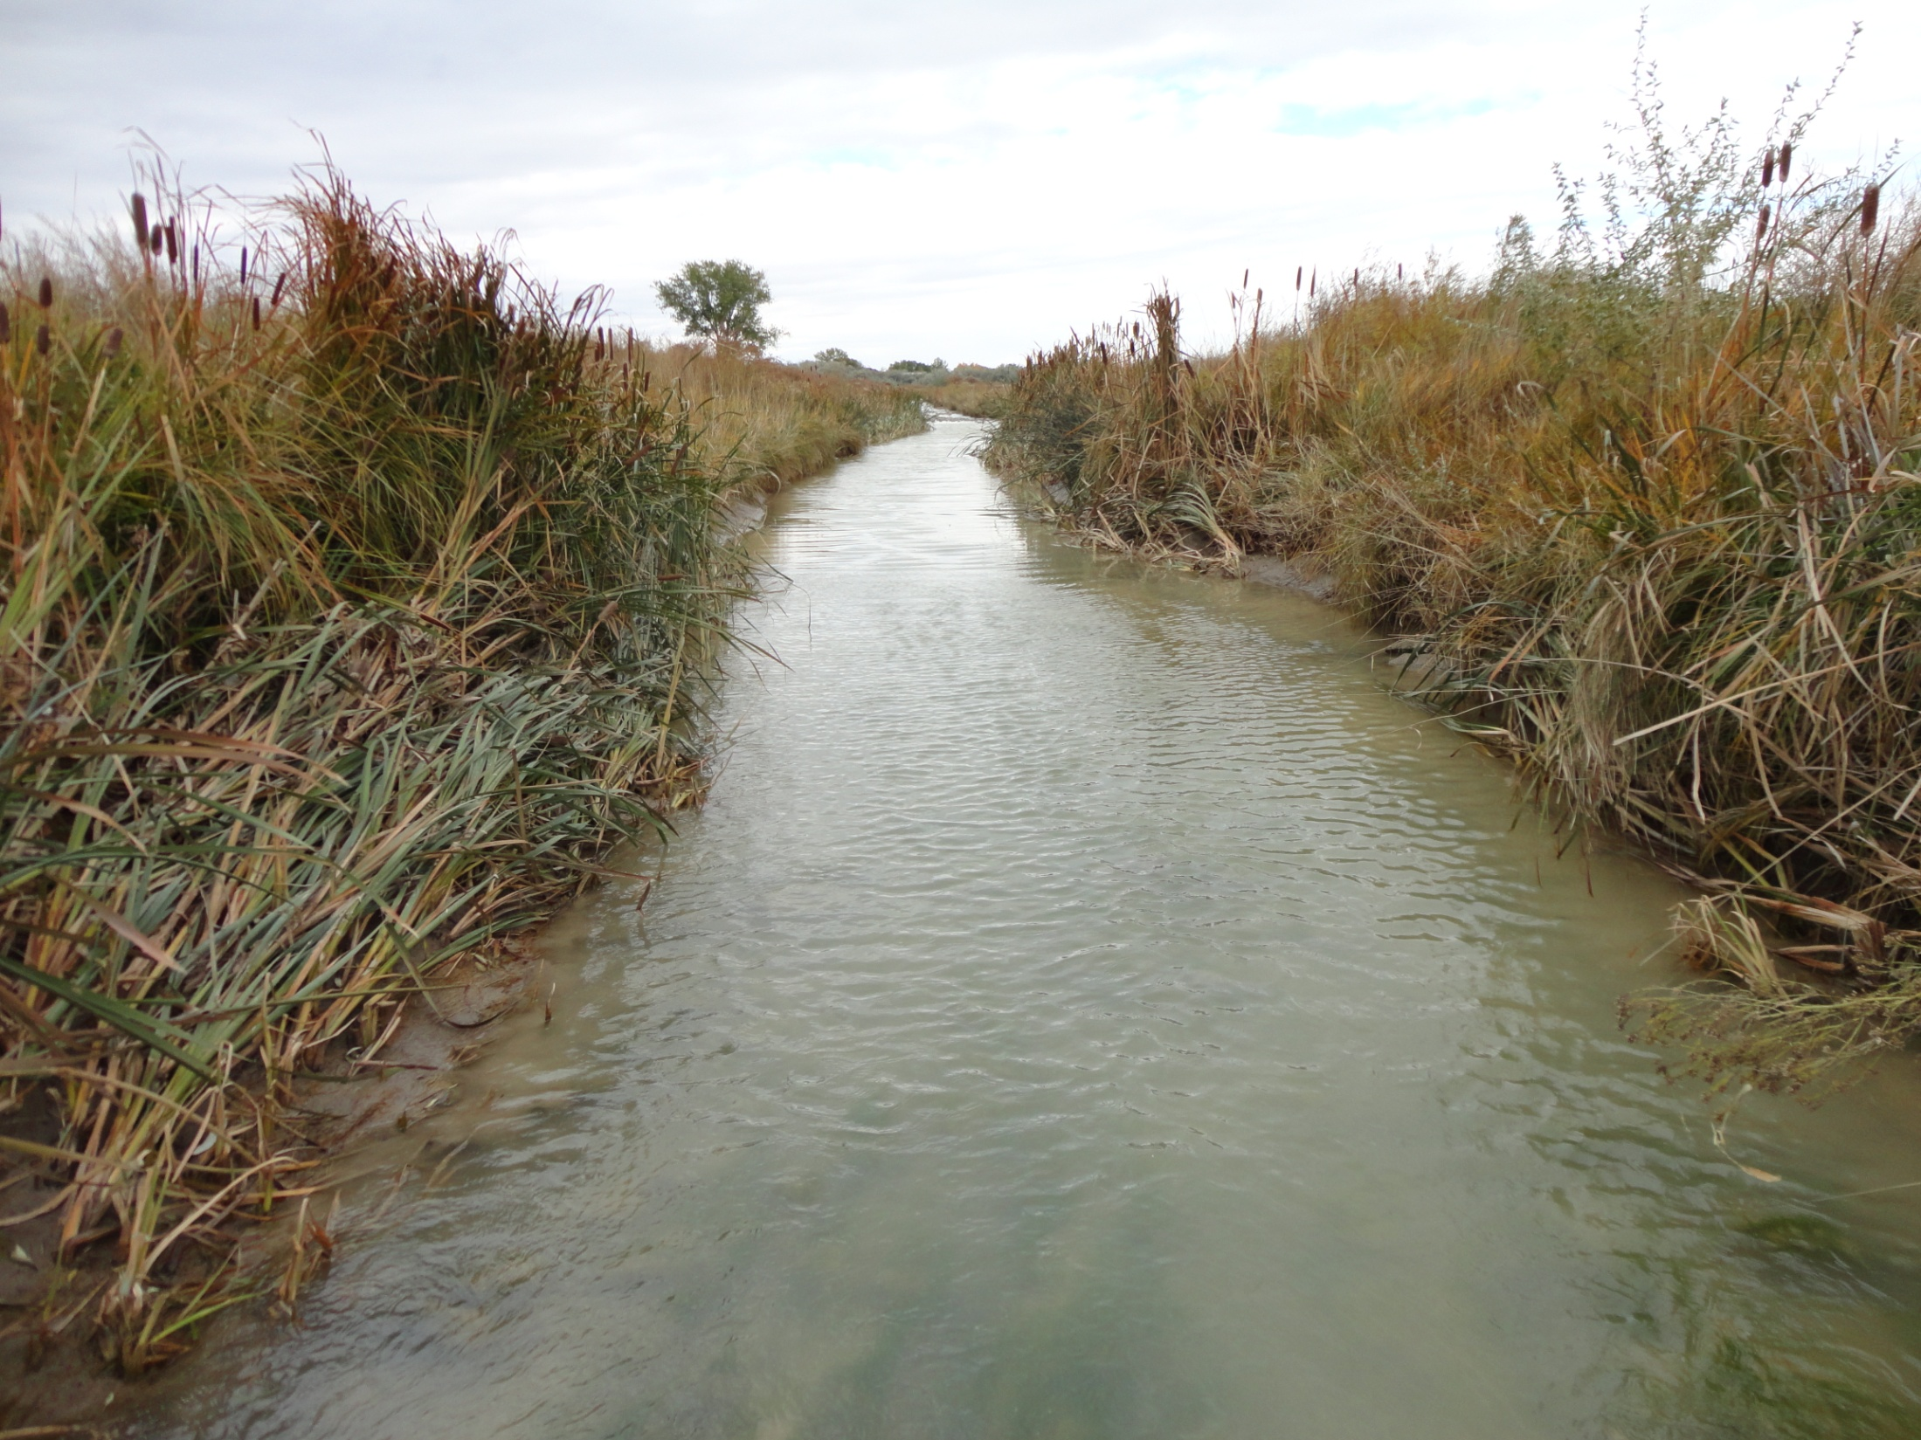
David Hamilton’s project; controlling erosion and sedimentation, creation of wildlife habitat, and development of wetland features
This is the photograph that EPA refused to allow the jury to see

